Slide 1
Book Clubs
Research Unit

Slide 2
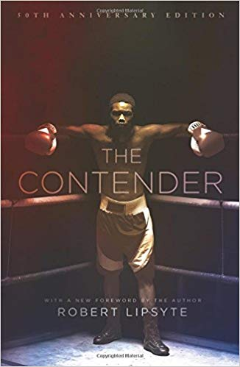
Contender
In the novel, Alfred Brooks is a black 17-year-old high school dropout living in Harlem in the mid-1960s. Alfred is dissatisfied with his job and confused by the changes he sees going on around him and begins training at Donatelli's Gym to become a boxer.
Possible Topics: Drugs
Black Nationalism
Boxing
Cus D’Amato
Domestic Abuse
Urban Poverty

Slide 3
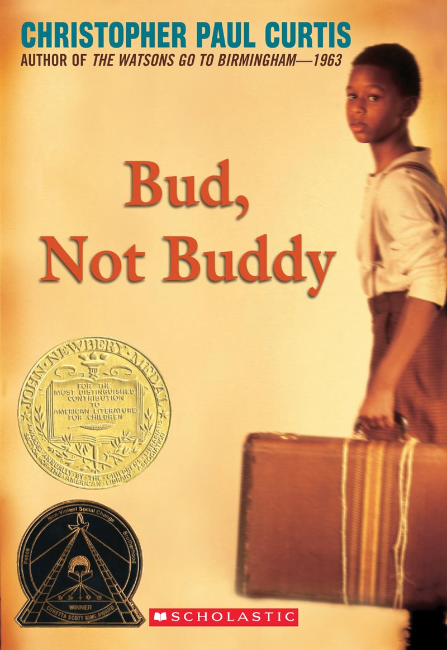
Bud, Not Buddy
Bud, Not Buddy is the story of 10-year-old orphan Bud Calloway finding his family in the Great Depression. Bud runs away from abusive foster parents, tries and fails to ride the rails, and walks for miles and miles to get to Grand Rapids, where he believes his father lives.
Possible Topics: Great Depression
Jazz
Adoption/Foster Care
Flint, Michigan
Runaways
Hoovervilles

Slide 4
Flush
The plot centers around Noah Underwood, a boy whose father enlists his help to catch a repeat environmental offender in the act. Noah Underwood’s Dad failed to prove that the Coral Queen was dumping their waste in Thunder Beach. So Noah and his sister Abbey will find a way to tell the community about the Coral Queen's secret.
Possible Topics: Environmentalism
Waste (Food/Sewage)
Cruise Ship Standards
Young Advocates

Slide 5
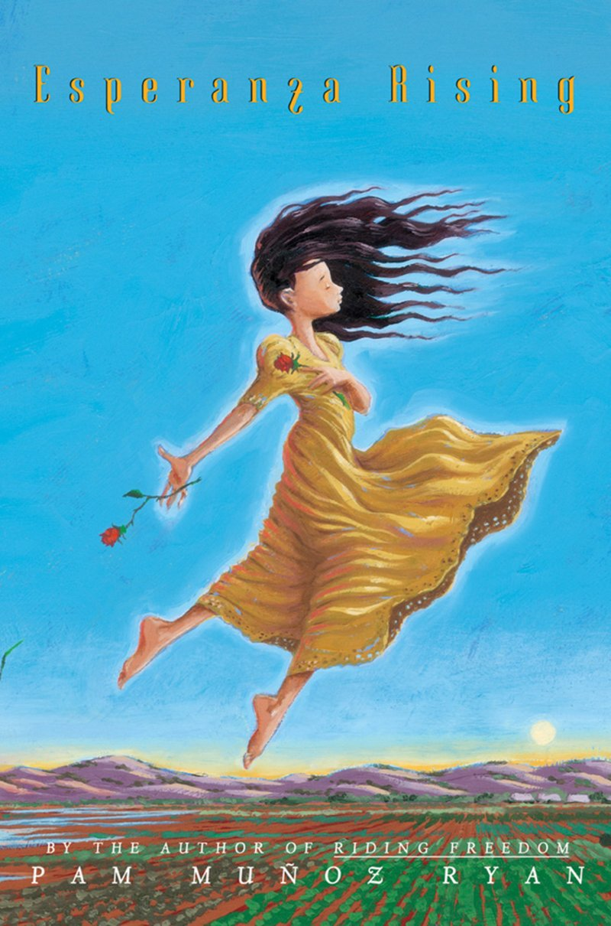
Esperanza Rising
Esperanza Ortega is a wealthy child in Aguascalientes, Mexico, daughter of wealthy landowner Sixto Ortega. She lives on her family's ranch, El Rancho de la Rosas, with her mother, father, and grandmother Abuelita. The day before Esperanza's 13th birthday, her father is murdered on his way to town.
Possible Topics: Mexican Revolution
Great Depression
Farming
Guerilla Movement
Cesar Chavez
Women’s Rights

Slide 6
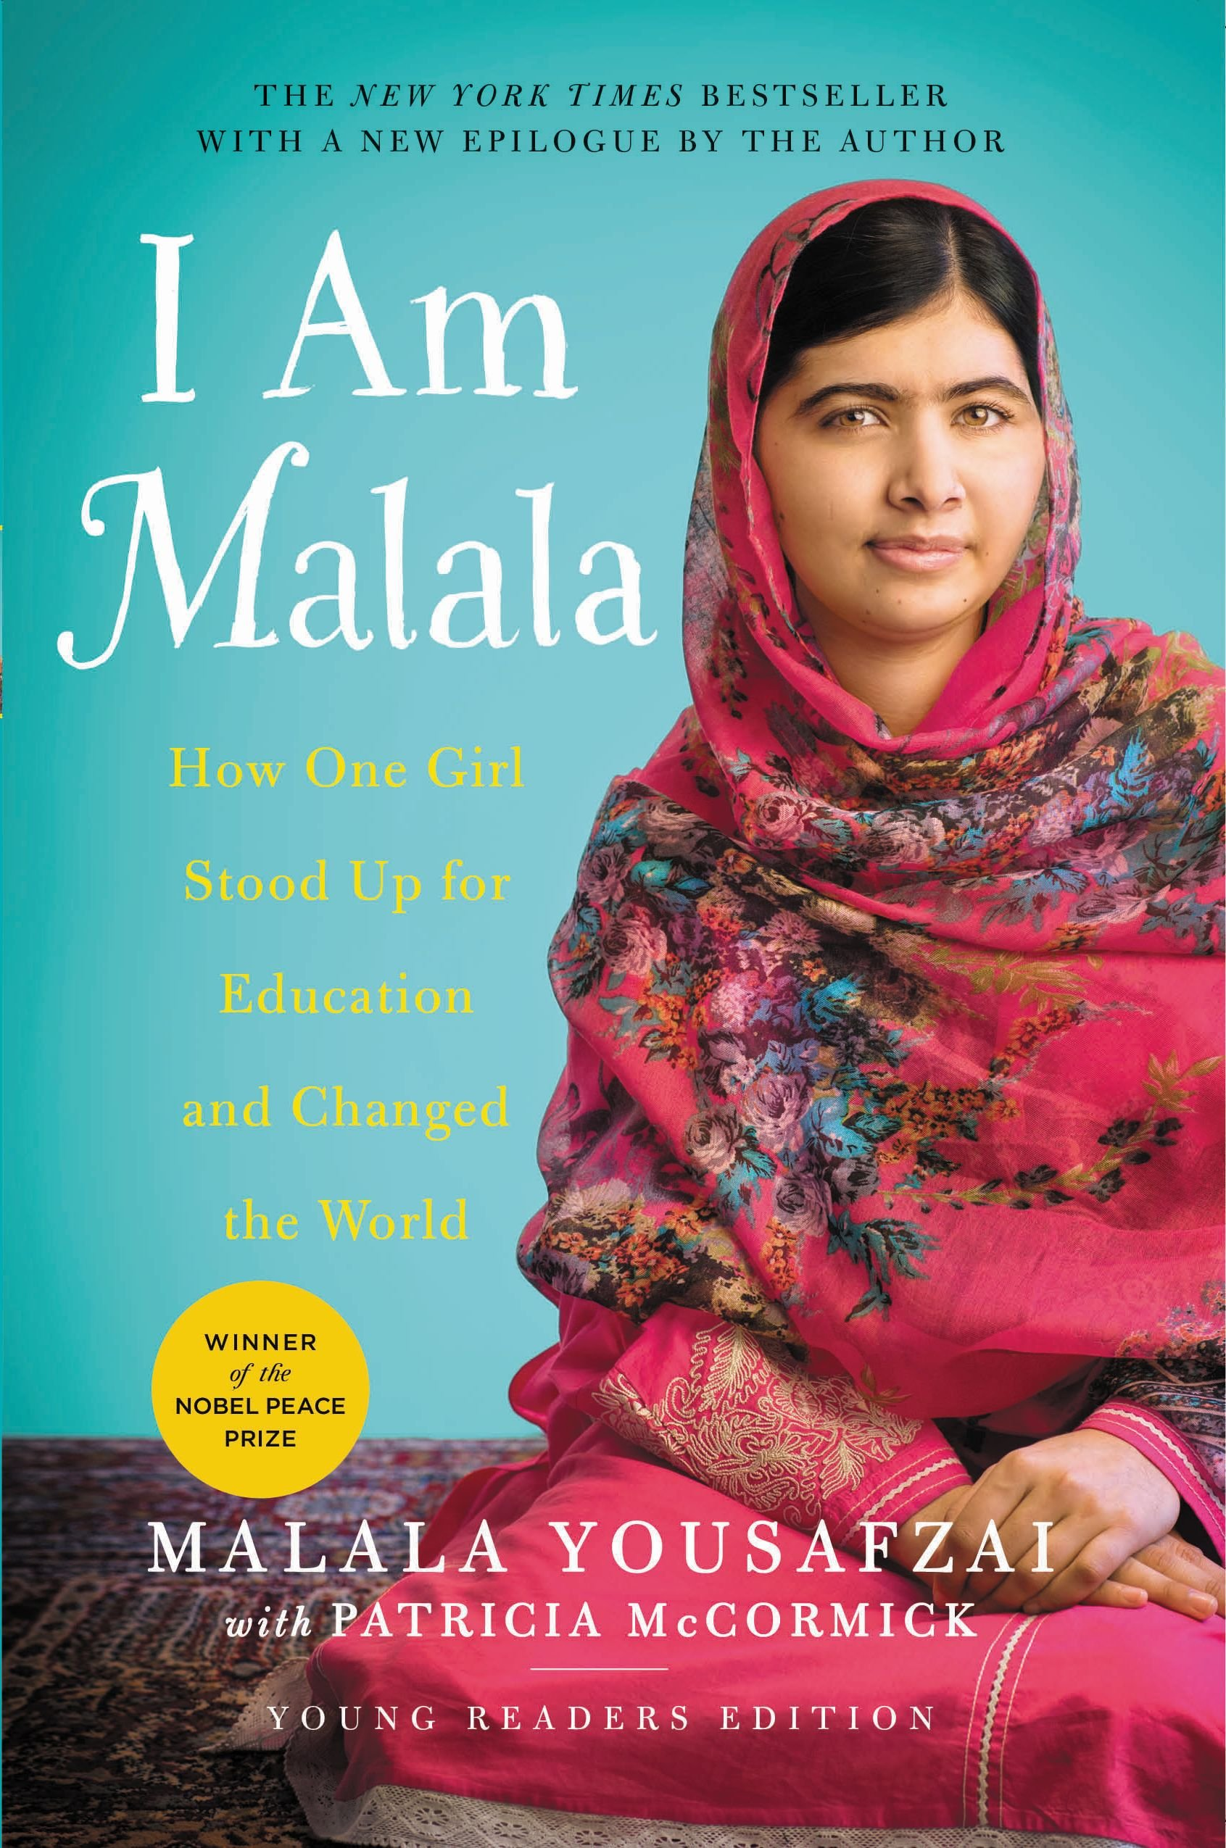
I Am Malala
The book details the early life of Yousafzai, her father's ownership of schools and activism, the rise and fall of the Tehrik-i-Taliban Pakistan in Swat Valley and the assassination attempt made against Yousafzai, when she was aged 15, following her activism for female education.
Possible Topics: Education for Girls
Young Advocates
Taliban
Social/Civil Issues in Pakistan
Gun Violence
Women’s Rights

Slide 7
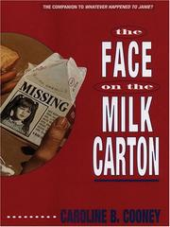
Face on the Milk Carton
The book is about a 15-year-old girl named Janie Johnson, who starts to suspect that she may have been kidnapped, and that her biological parents are somewhere in New Jersey. She happens to look down at a milk carton one day, and she sees what looks like herself on the back, under the heading "Missing Child." Her life gets more stressful as she tries to hide the secret from her "parents," who she believes did not kidnap her. Janie tells her next-door neighbor, Reeve, everything. Together the two of them unravel all of the secrets surrounding Janie Johnson's life.
Possible Topics: Missing Children
Kidnapping
DNA/Genetics
Adoptive Parents

Slide 8
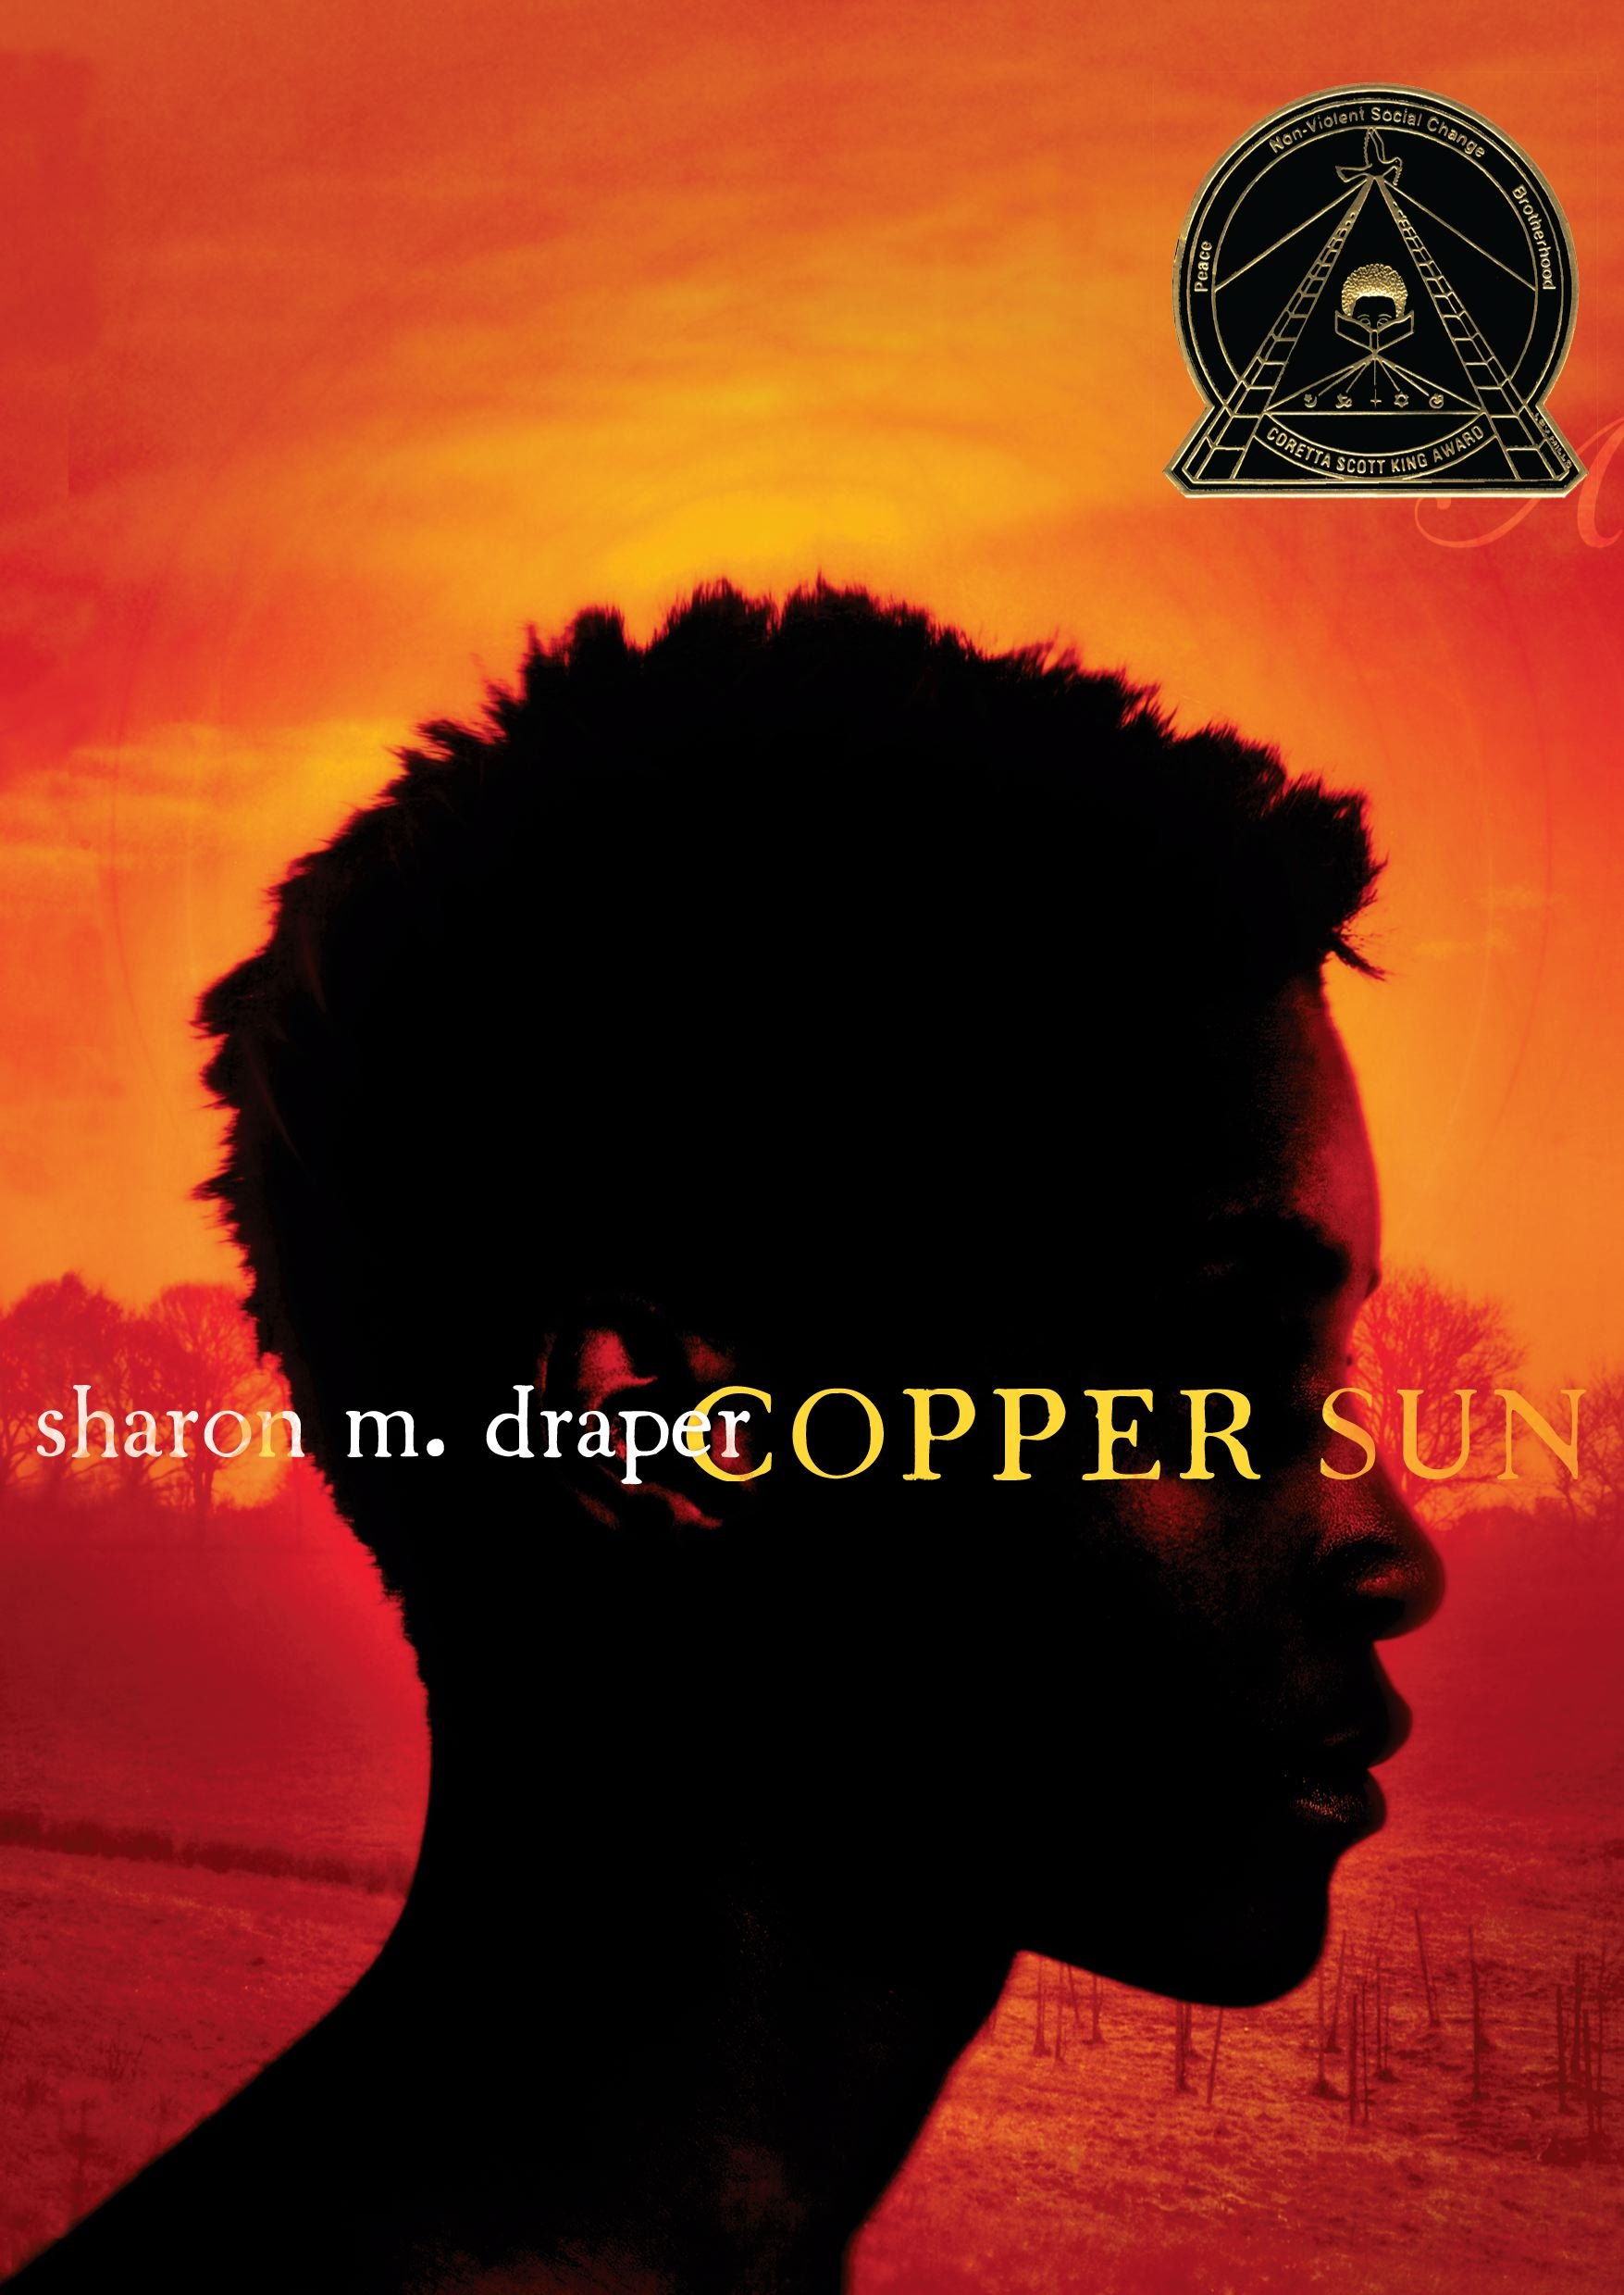
Copper Sun
Copper Sun is a historical fiction novel about fifteen-year-old Amari, a young woman from Ziavi, Ghana. Amari loves her community (the Ewe people), her family, and her soon-to-be husband, Besa. One day, unannounced, a group of pale-faced strangers arrive, led there by a neighboring tribe, the Ashanti. Amari’s people prepare a celebration to welcome the guests, not knowing the grave danger they will soon face. After a meal, gift exchange, storytelling, and dancing, the white men open fire on the community. Amari watches as her parents are murdered. She runs into the jungle with her little brother, Kwasi, but he is speared and killed. She is then shackled and chained to fellow surviving villagers.
Possible Topics: Slavery
Ghana
Point of No Return
Slave Trade
Slave Owners

Slide 9
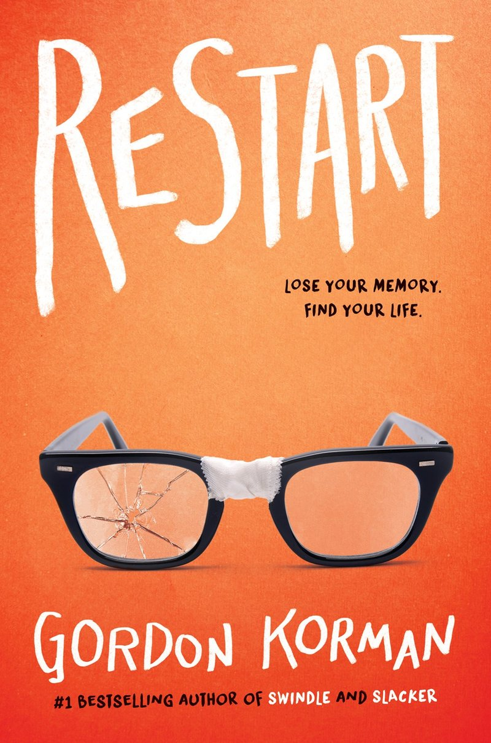
Restart
What would it be like to forget your whole life, your family, your friends, and even who you are? After falling off his roof, 13-year-old Chase Ambrose learns the hard way that reinventing himself can be pretty hard, especially when his past is not what he wants for his future. Before his fall, Chase was a jock, captain of the football team, following in his father's footsteps. He was also the biggest bully in his middle school, had made many students' lives miserable, and was serving a community service sentence for the damage that his bullying had caused.
Possible Topics: Bullying
Puberty
Adolescence
Tolerance
Juvenile Justice
Memory Loss

Slide 10
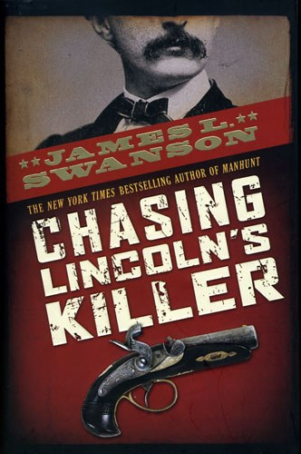
Chasing Lincoln’s Killer
Based on rare archival material, obscure trial manuscripts, and interviews with relatives of the conspirators and the manhunters, Chasing Lincoln's Killer is a fast-paced thriller about the pursuit and capture of John Wilkes Booth: a wild twelve-day chase through the streets of Washington, D.C., across the swamps of Maryland, and into the forests of Virginia.
Possible Topics: Civil War Abraham Lincoln
Conspirators
John Wilkes Booth
Union/Confederacy
Murder Investigations

Slide 11
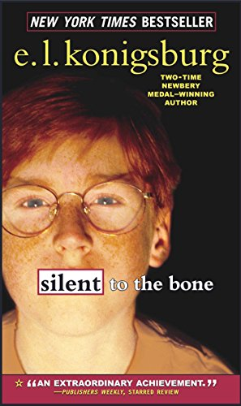
Silent to the Bone
Silent to the Bone is a first-person narrative by Connor Kane, a 13-year-old boy. Connor's best friend Branwell Zamborska is struck dumb and taken to the Juvenile Behavioral Center when his infant sister Nicole suffers a head injury and slips into a coma. The nanny, Vivian, having completed Branwell's 9-1-1 call, asserts that Branwell must have dropped Nikki…
Possible Topics: Blended Families
Juvenile Justice
Sign Language
Traumatic Brain Injuries
Comas
Behavioral Science

Slide 12
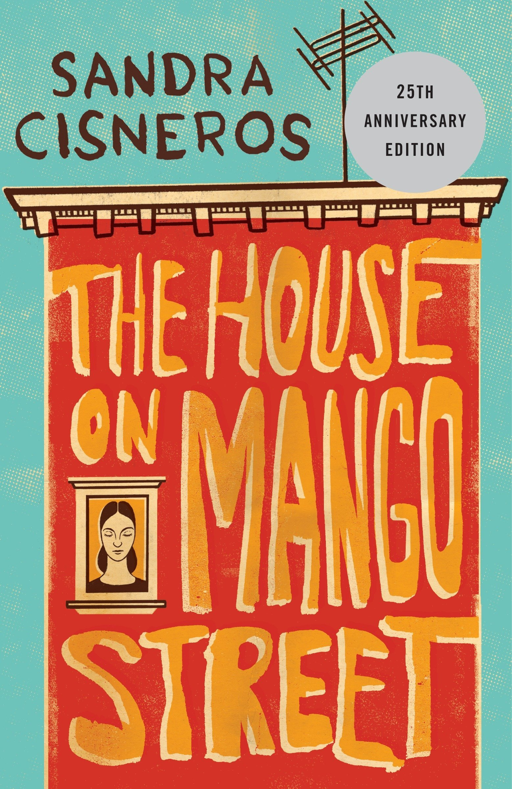
House on Mango Street
Esperanza wishes to escape her impoverished life in her small red house on Mango Street to then return one day to rescue her loved ones as well. The novel follows Epseranza as she struggled to be a Mexican girl in a predominately white country.
Possible Topics: Racial Prejudice
Feminism
Abuse
Adolescence
Puberty
Marxism

Slide 13
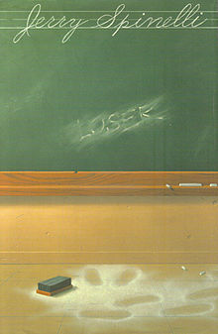
Loser
Loser is a coming of age young adult novel. It details the growth of Donald Zinkoff, who is branded a "loser" by his classmates due to his clumsiness, poor performance in school and athletics, and sometimes clueless enthusiasm.
Possible Topics: Bullying
Puberty
Adolescence
Tolerance

Slide 14
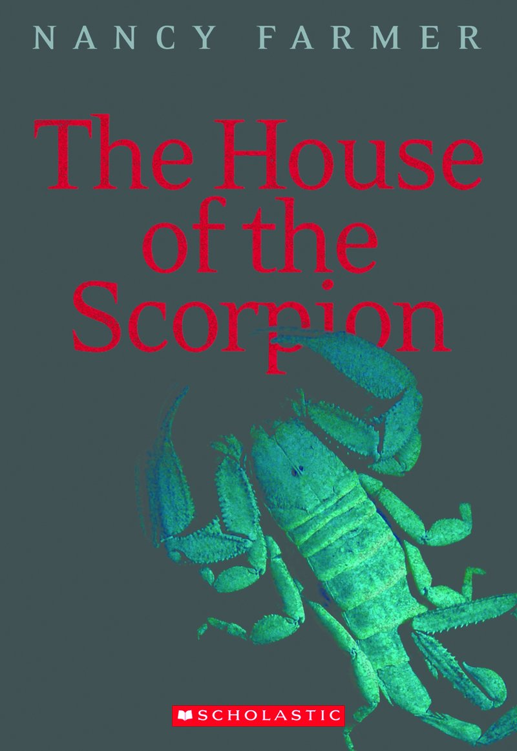
House of the Scorpion
The story is set in the country of Opium, a narrow strip of land between Mexico (now called Aztlán), and the United States, which is ruled by Matteo Alacrán, or El Patrón, an incredibly powerful drug lord who is over 140 years old.
Possible Topics: Drugs
Drug Trafficking
Genetics
Cloning

Slide 15
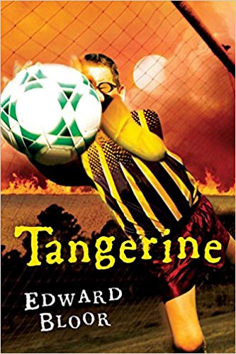
Tangerine
While Paul is at school, a field of portable classrooms collapses into a sinkhole. Many people, including Paul and Joey, try to rescue those trapped, and no one is seriously injured. The emergency relocation plan gives the students the choice to stay at Lake Windsor, their present school, with a different schedule and more crowded classes, or to transfer to Tangerine Middle School, on the other, poorer side of the county; and Paul chooses Tangerine Middle, to play soccer again.
Possible Topics: Classism
Visual Impairment
Racism
Perception vs Reality

Slide 16
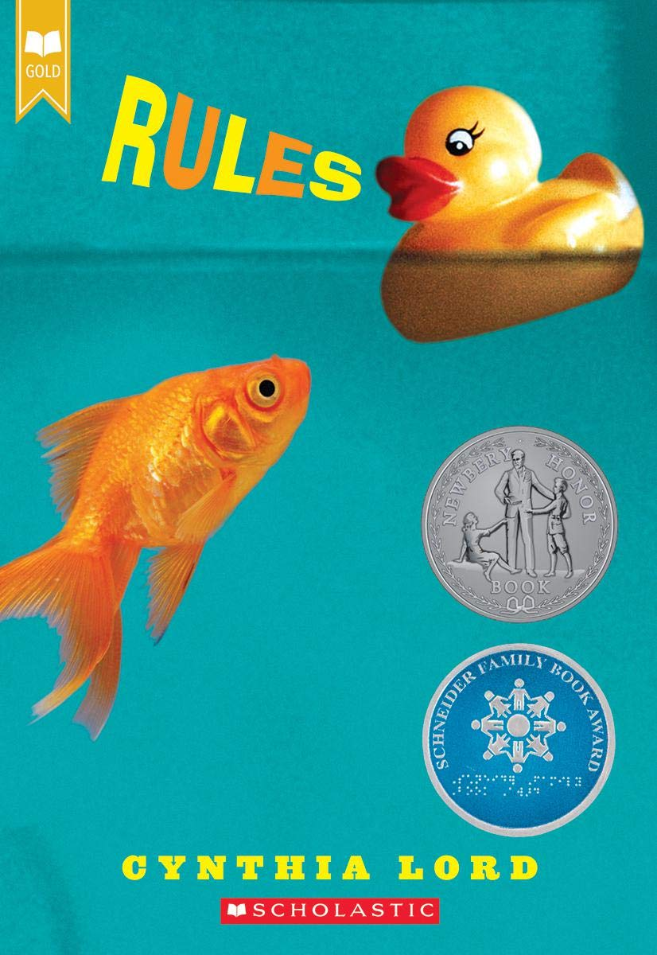
Rules
Twelve-year-old Catherine just wants a normal life. Which is near impossible when you have a brother with autism and a family that revolves around his disability. She's spent years trying to teach David the rules, from "a peach is not a funny-looking apple" to "keep your pants on in public," in order to stop his embarrassing behaviors. But the summer Catherine meets Jason, a paraplegic boy, and Kristi, the next-door friend she's always wished for, it's her own shocking behavior that turns everything upside down and forces her to ask: What is normal?
Possible Topics: Stereotypes
Consequences
Special Needs
Tolerance
Autism
Paraplegic

Slide 17
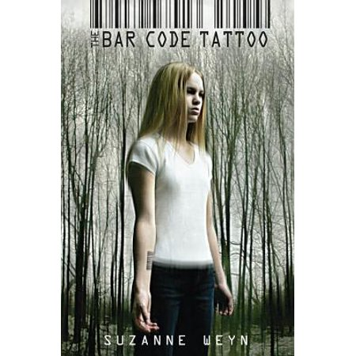
Bar Code Tattoo
The bar code tattoo. Everybody's getting it. It will make your life easier; they say. It will hook you in. It will become your identity. But what if you say no? What if you don't want to become a code? For Kayla, this one choice changes everything. She becomes an outcast in her high school. Dangerous things happen to her family. There's no option but to run...for her life.
Possible Topics: Conformity
Society Pressure
Government Control
Dystopias

